Slide 1
Version 6.4

Slide 2
Dan Gordon
CEO, Co-Founder
Rick Bantelman
VP, Sales
Scott Miller
VP, Engineering
Today’s MyWorkDrive Presenters
Notes:
We will respond to questions at the end and provide a recording to all registrants

Slide 3
About MyWorkDrive
Secure File Share Remote Access from any OS stored on any platform without Vendor Lock-in.
Customers include Enterprises, Governments, Higher Education, Health Care
Notes:
No MDM Needed

Slide 4
For Today
1
What is MyWorkDrive?
2
Client-Side Demo
3
Server Demo
4
Q&A
www.myworkdrive.com

Slide 5
Secure File Share Remote Access
Instantly add Cloud File Sharing capabilities to Windows File Shares without VPN, syncing or migrating data.
Better security and control using existing Infrastructure without VPN, Vendor Lock-in or storing files in databases.
Notes:
MyWorkDrive was founded around the core value that organizations should have the option to retain ownership and control of their files, whether they are stored online or locally, in standard NTFS file formats. We believe organizations should not be forced to migrate, convert or store them in proprietary cloud storage file formats requiring vendor lock-in

Slide 6
Secure File Share Remote Access
Web Browser
Mapped Drive
Mobile
Notes:
Dan

Slide 7
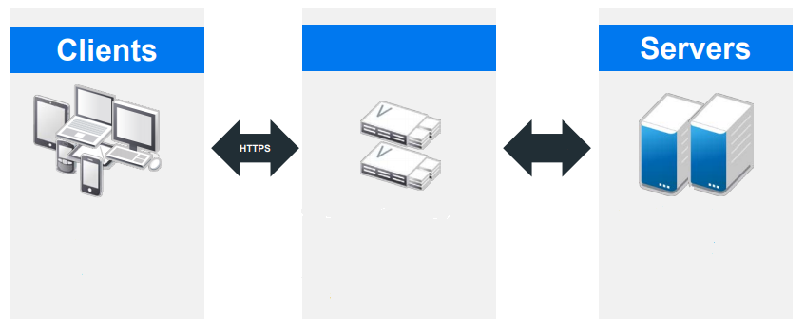
MyWorkDrive Network Overview
MyWorkDrive
MyWorkDrive
HTTPS
Storage
User Access
Desktop
Mobile
Browser
Windows Web Server
Physical, Virtual or Azure
Storage Services
Windows Shares, SMB, NAS Appliance, OneDrive, SharePoint
www.myworkdrive.com

Slide 8
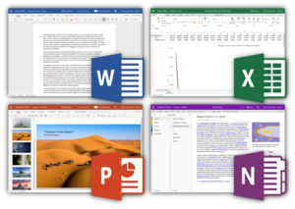
MyWorkDrive Office Online Editing
1
No migration of files required
2
Co-editing of Office Files
3
Edit from the browser, mapped drive or mobile client
4
Edit with OneDrive, SharePoint, Office Online or Only Office Servers on-premise
Notes:
Dan

Slide 9
MyWorkDrive Compliance Security Features
DUO/ADFS/SAML Two Factor Authentication
File Type Blocking and Alerting
New Device Approval for Client Devices
Pre-Auth for Identity Providers (Conditional Access)
Data Leak Prevention with encrypted view & Watermarks
DLP Protected Mapped Drive Access
External Guest User Folder Sharing & Collaboration
GDPR ♦ FIPS ♦ HIPAA ♦ FINRA ♦ FEDRAMP ♦ CMMC
Notes:
Dan

Slide 10
MyWorkDrive
Version 6.4 Demo
Client Demo
Server Demo
www.myworkdrive.com
Notes:
Rick

Slide 11
MyWorkDrive 6.4 Highlights
1
One/Drive SharePoint
SharePoint and OneDrive are collaboration and document management platforms by Microsoft which can now be integrated with MyWorkDrive for file access and storage services.
2
Public File/Folder sharing securely
Permits users to share files and folders with 3rd party (non MyWorkDrive) users via a URL.
New Consolidated Integrations Tab
We moved all 3rd party integrations to their own tab in the Server Admin Panel called Integrations. This simplifies and enhances support and availability of 3rd party services and storage providers.
3
Notes:
Dan

Slide 12
Roadmap
Azure AD Authentication
Azure File Shares/API
Azure Blob Storage/API
Notes:
Dan

Slide 13
Questions About MyWorkDrive?
Contact Us For More Information:
sales@myworkdrive.com
Find Us On The Web:
www.myworkdrive.com
www.myworkdrive.com

Slide 14
External Public File Sharing
Notes:
Dan

Slide 15
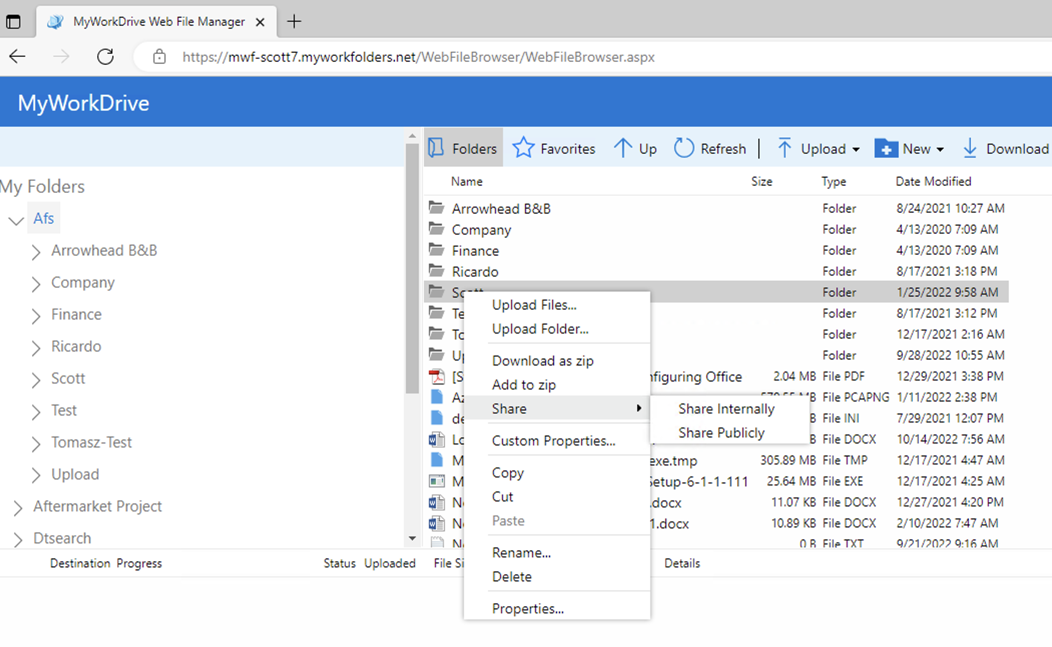
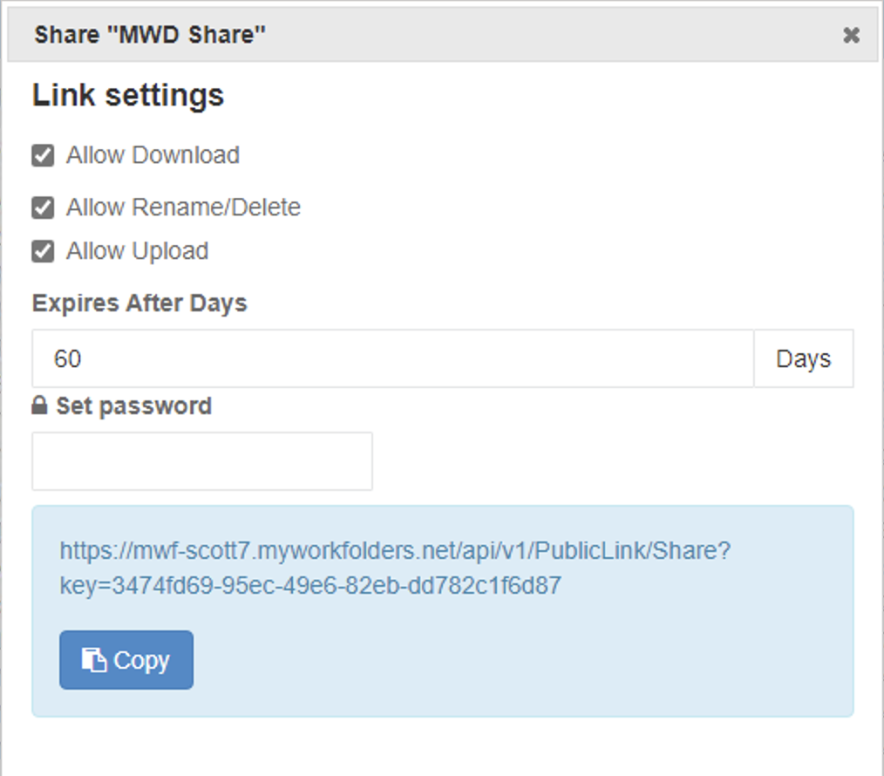
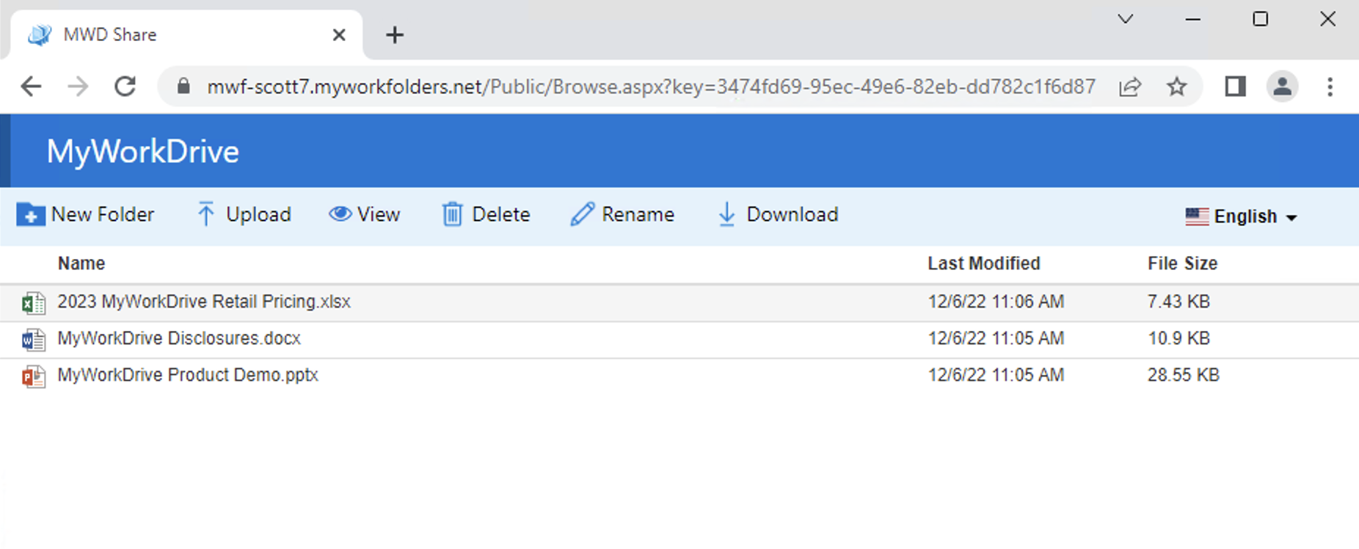
Web Client
Public sharing
Share a file
Shared User View

Slide 16
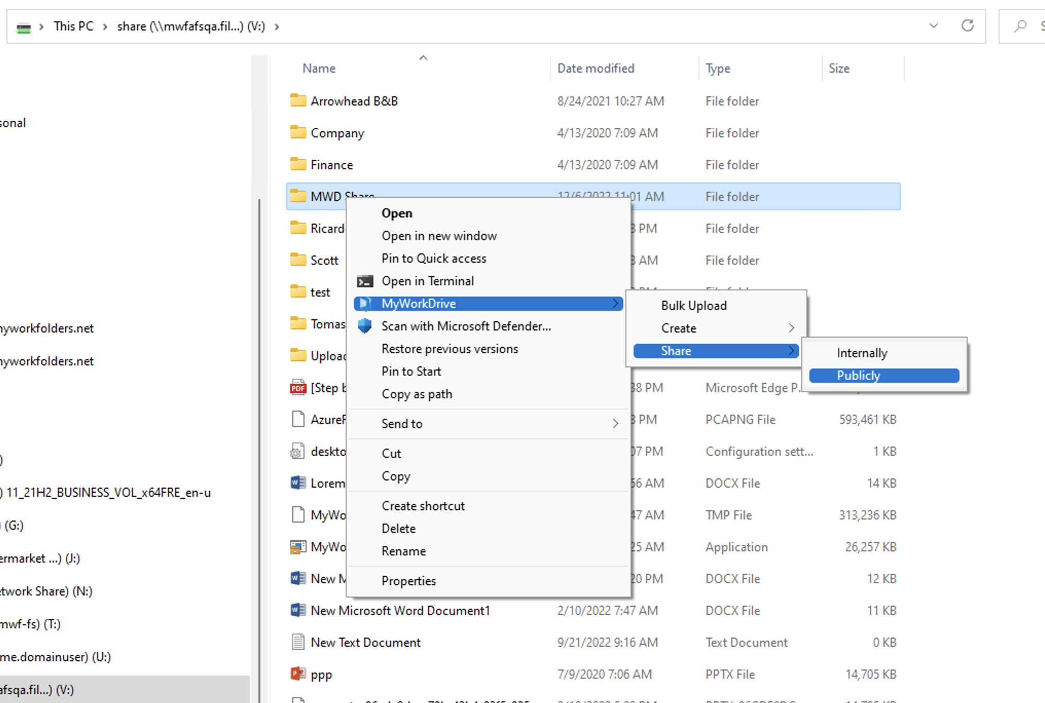
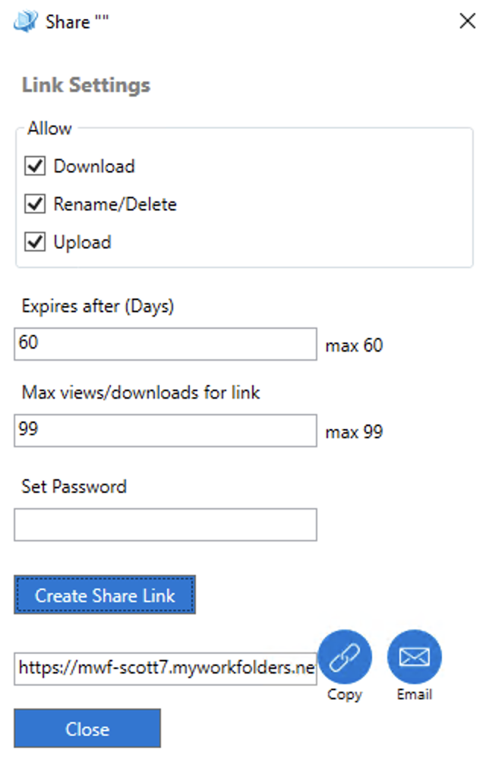
Map Drive
Share a File/Folder
Share a File/Folder Details

Slide 17
OneDrive/SharePoint
Storage
Notes:
Dan

Slide 18
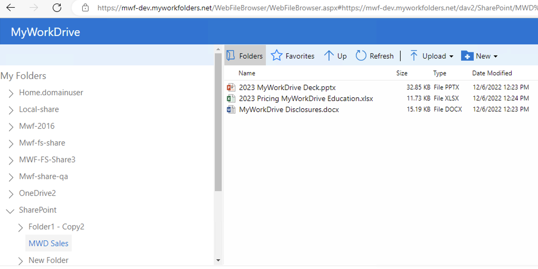
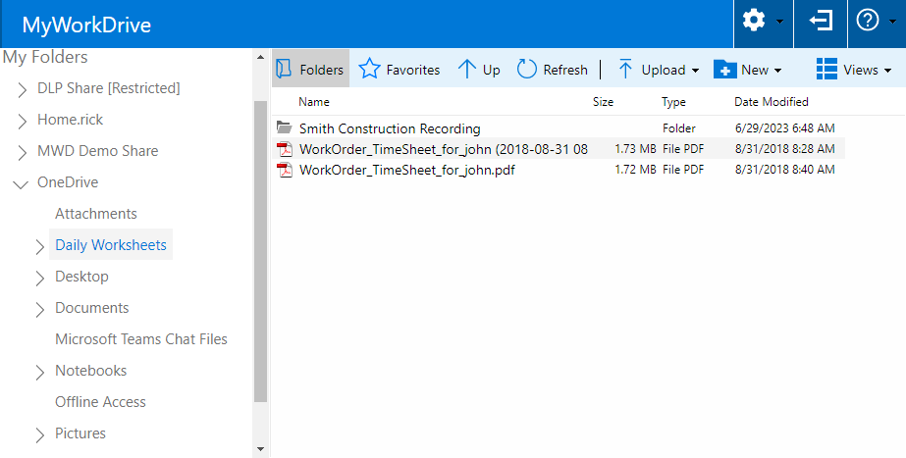
MyWorkDrive Web Client
Web client View – SharePoint Site
Web client View – OneDrive Site

Slide 19
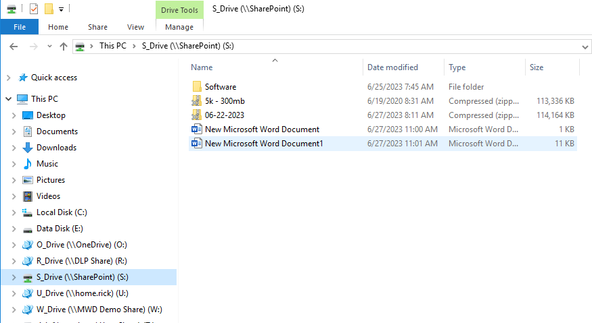
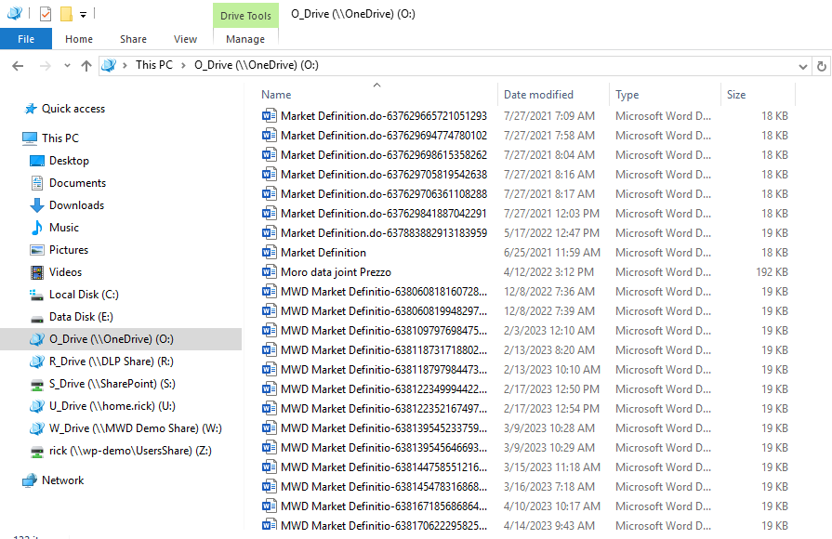
MyWorkDrive Map Drive Client
SharePoint Site
OneDrive

Slide 20
Integrations Tab
Notes:
Dan

Slide 21
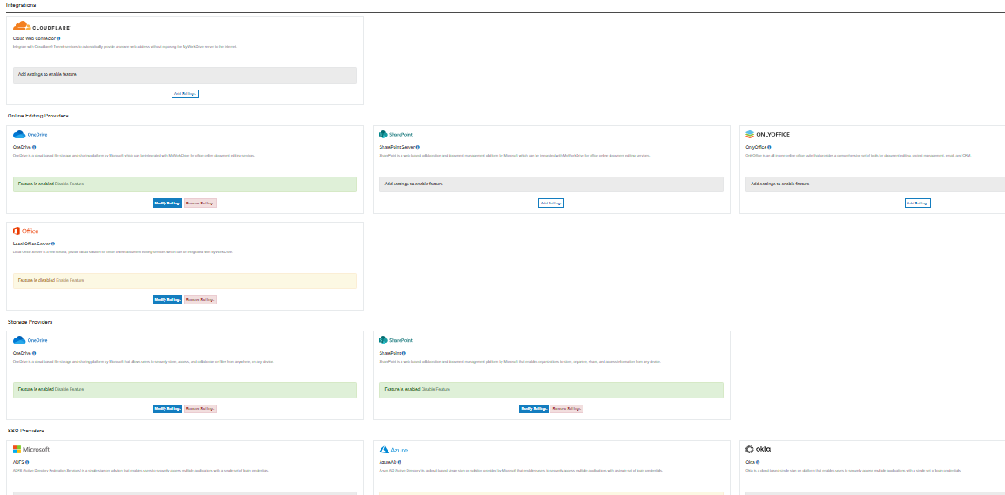

Slide 22
Web Client
Public sharing

Slide 23
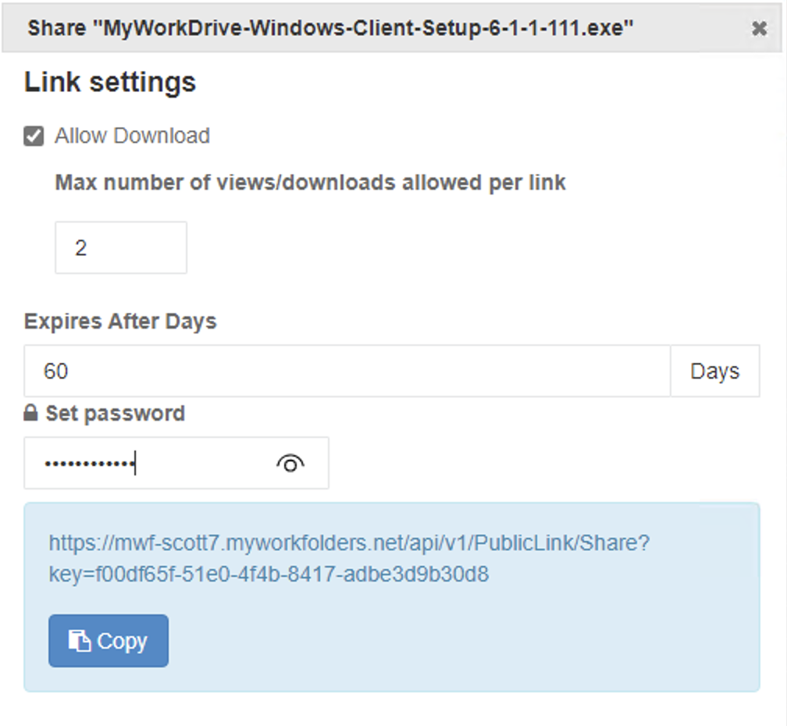
Web Client
Share a File

Slide 24
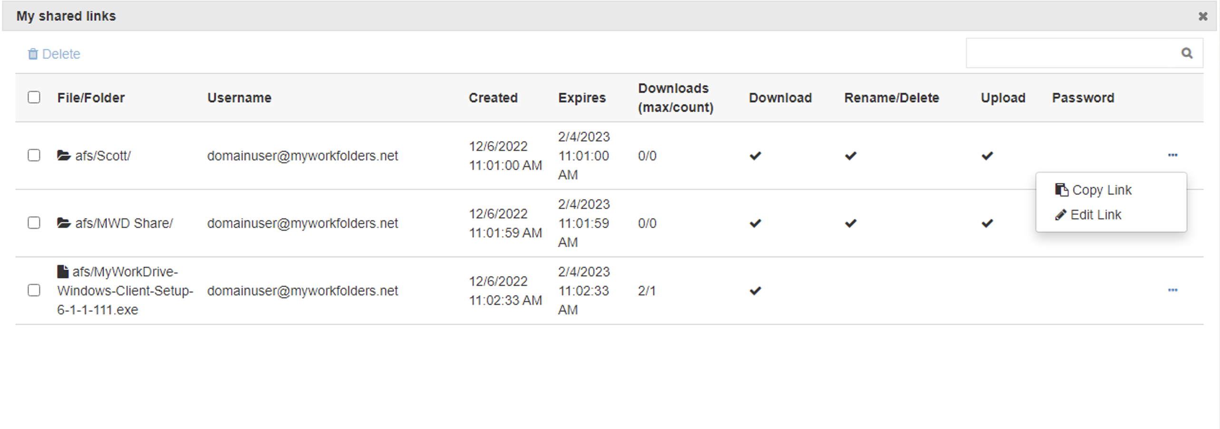
Web Client
User Share Management

Slide 25
Web Client
Shared User View

Slide 26
Map Drive
Share a File/Folder

Slide 27
Map Drive
Share a File/Folder Details

Slide 28
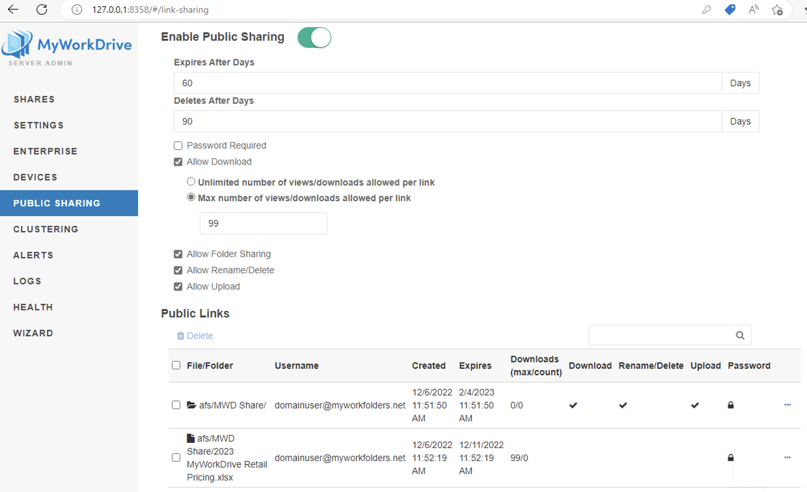
MyWorkDrive Server
Administrator Settings

Slide 29
MyWorkDrive Web Client
Web client View – SharePoint Site

Slide 30
MyWorkDrive Web Client
Web client View – OneDrive Site

Slide 31
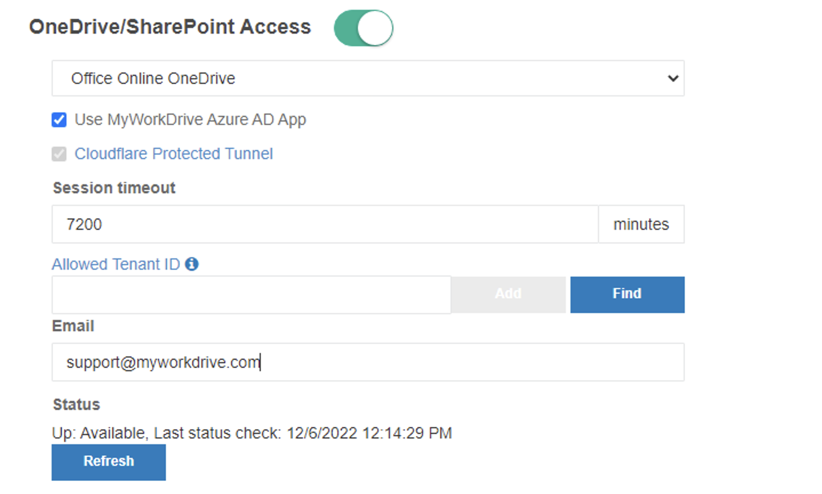
MyWorkDrive Admin
Administrator Setup - Simple

Slide 32
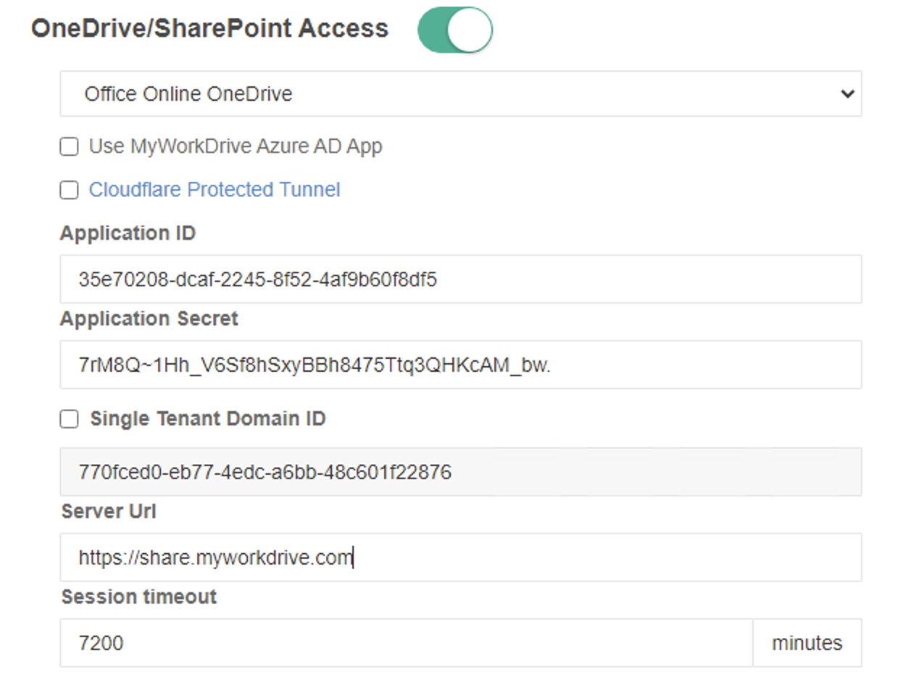
MyWorkDrive Admin
Administrator Setup - Advanced

Slide 33
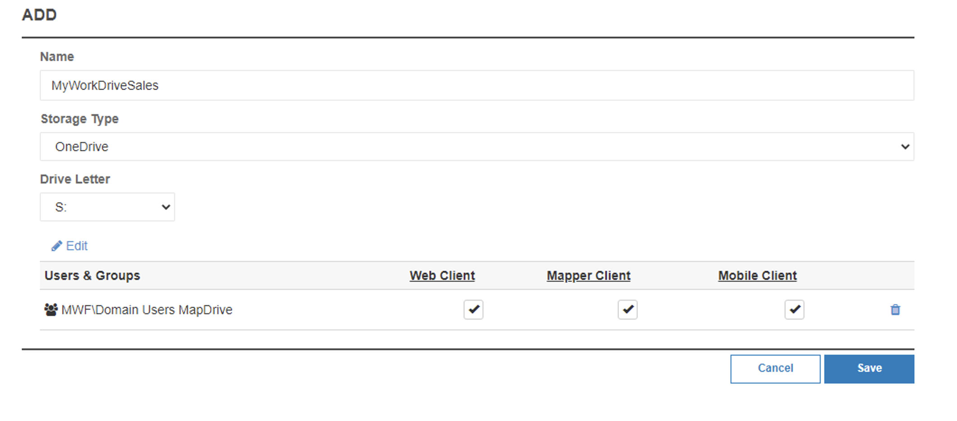
MyWorkDrive Admin
Administrator Add Share - OneDrive

Slide 34
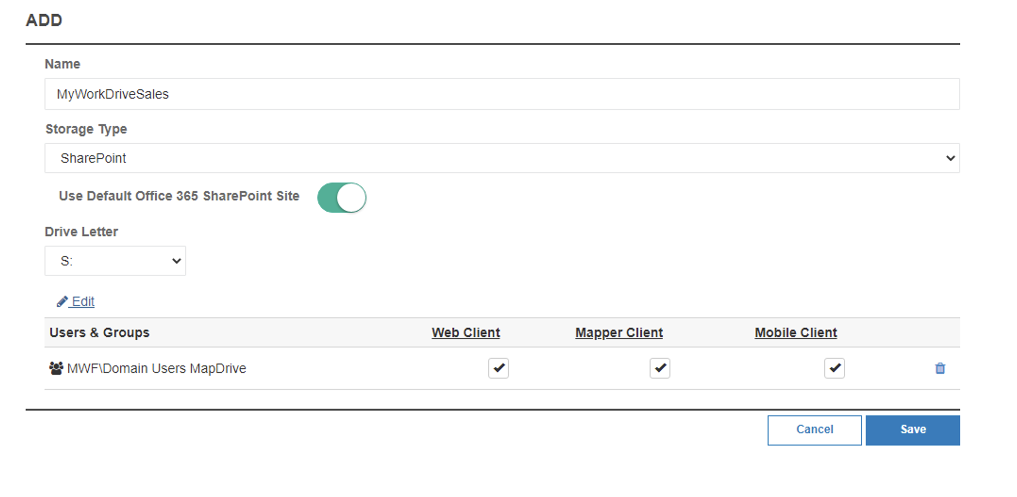
MyWorkDrive Admin
Administrator Add Share – SharePoint Simple

Slide 35
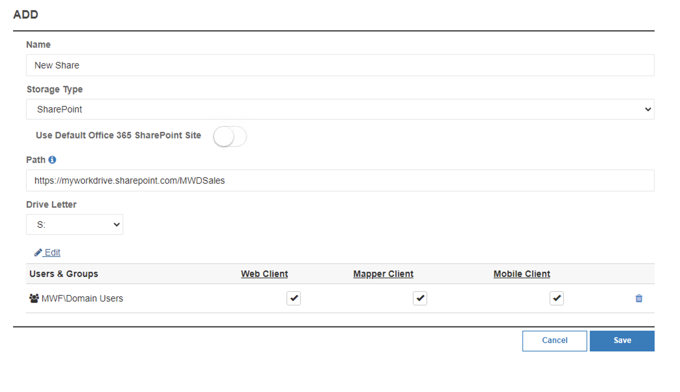
MyWorkDrive Admin
Administrator Add Share – SharePoint Advanced

